Slide 1

EEE 204-CSE(181)
Electronic Devices and Circuits & Pulse Techniques Lab
Topic: Operational amplifier
PRESENTED BY
Towhid Alom (213015026)
Course Instructor
Md. Nayem Sharkar
Lecturer
Department of CSE
Green University of Bangladesh
Page: 1

Slide 2
EEE 204-CSE(181)
Table of Contents
Page
Introduction 3
Types of op-amp 4
Pin diagram of op-amp 5
Conclusion 6
Page: 2

Slide 3
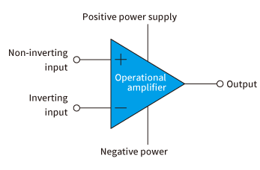

EEE 204-CSE(181)
Introduction
what is an operational amplifier?
Basic Characteristics of op-amp?
Page: 3

Slide 4
EEE 204-CSE(181)
Types of op-amp
Inverting Amplifier
Differential amplifier
Summing amplifier
operational amplifier
Instrumentation amplifier
Integrator
Audio op amps
Comparator
Page: 4

Slide 5
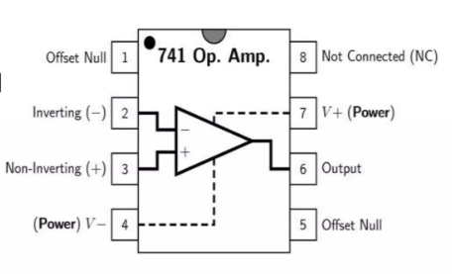
CSE 303-CSE(181)
Pin Diagram
There are 8 Pins in a Common op-amp, like the 741 which is used in many instructional courses
Page: 5

Slide 6
EEE 204-CSE(181)
Conclusion
Summarize the key characteristics and applications of operational amplifiers.
Emphasize their significance in modern electronic circuit design.
Page: 6

Slide 7

CEEE 204-CSE(181)
‹#›
The End

